Slide 1
Tetris Agent
Final Project – Midway Meeting
16.4.2023
Itai Bear, itai.bear1@gmail.com
Noam Manaker Morag, noam.school.only@gmail.com
GitHub: github.com/ItaiBear/AtariGameMaster

Slide 2
Project Goal
Our project goal is to use Reinforcement Learning to train an agent to play a retro game
We want to use DQN (Deep Q Network) as the training algorithm
We want the AI to learn to play the game without any prior knowledge or assistance

Slide 3
Learning Phase
Before we could begin training the AI, we needed to learn the necessary tools for reinforcement learning:
We completed the Hugging Face Deep RL course
We viewed David Silver’s online videos on RL
We covered several RL algorithms and training tech
Now, we were ready to choose a game…

Slide 4
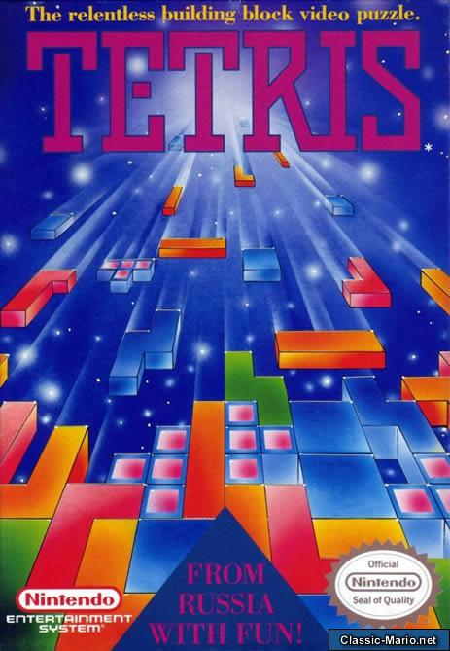
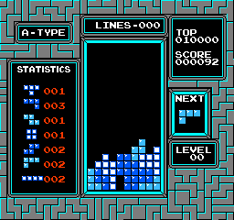
Why Tetris?
Tetris is a challenging game, poor decisions may only have a negative effect much later on
Tetris has a simple open-source gym environment for the original Nintendo NES game, which we can also modify
Has levels, making the game harder as the agent progresses
According to a paper from 2020, there are no non-population-based RL agents that are able to play the original NES Tetris without different simplification techniques of the state actions space, leaving plenty of room for research.

Slide 5
Approach
We want the model to learn how to play “on its own”
We want to use the DQN learning algorithm
We can control 2 things:
The Neural Network
The Reward Function
Therefore, our goal thus far was to search for a suitable neural network and reward function

Slide 6
What we have tried so far
Models | Reward Functions
We tried 5 different Neural Networks with varying sizes and different combinations of: 2D Convolutional layers Max Pooling layers Dropout layers Fully Connected Layers We found that using larger models did not improve performance | We tried many reward functions based on several metrics: In-Game score Number of lines removed Board Height Number of “holes” We tried many combinations of these different metrics

Slide 7
Findings
The greatest difficulty is that it is very hard to clear a line with pure randomness
This means that simply rewarding the AI for each line cleared is not sufficient, as the AI agent can only begin to learn once a line has been cleared
For these reasons we decided to try more complicated reward functions
We used hyperparameter optimization library Optuna to search for the best combination of Neural Network and reward function as well as optimizing other hyperparameters (such as learning rate)
Unfortunately, all the different trials failed to consistently clear a line

Slide 8
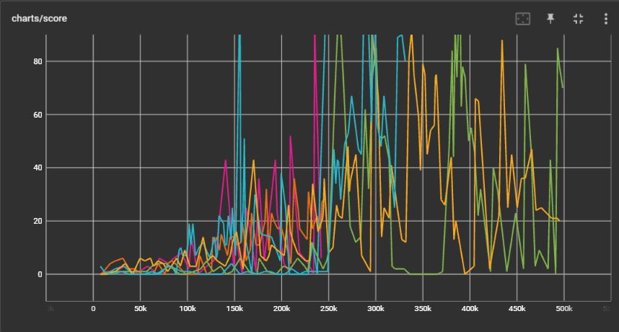
Results From Optuna Hyperparameter Search

Slide 9
Future Work
Continue Searching For a Solution
State Space Reduction
Continue to try more complex reward functions to guide the model towards packing the board more efficiently
Use more advanced training algorithms
Accept that our goal was too high
Try different ways to simplify the game state so the model can learn easier
Give the model basic prior knowledge of the game by copying real human behavior

